Slide 1
GASTRO-INTESTINAL SURGERY
Presented by
Dr AbdEl-Haleem Hamada El-Kasapy
Lecturer of Surgery& Radiology and Anesthesiology
Director of Student Surgical Project
Best PhD Thesis in Benha University
Faculty of veterinary medicine
Benha University

Slide 2
Foreign Bodies in The Gastro-Intestinal Tract in Dogs and Cats
Causes
1-Swallowing of a needle with thread after playing with the thread.
2.Swallowing of different types of rubber objects and stoppers of penicillin vials.
3. Pieces of stones. 4. Pieces of bones.
4. Different types of nuts.

Slide 3
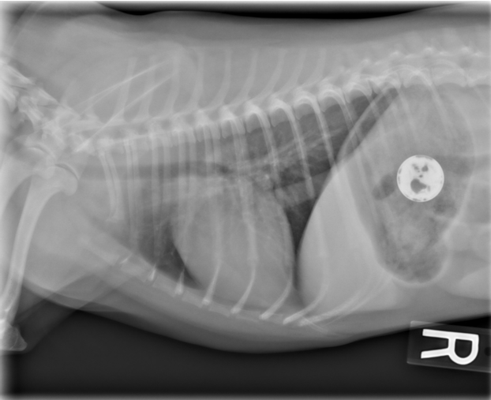
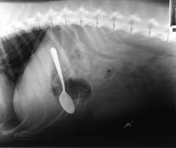
Foreign bodies in the stomach: have no sure symptoms
Loss of appetite.
Changes in the temperament of the animal.
Pain manifestation.
Sometimes vomition of the stomach content

Slide 4
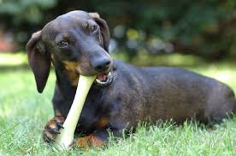
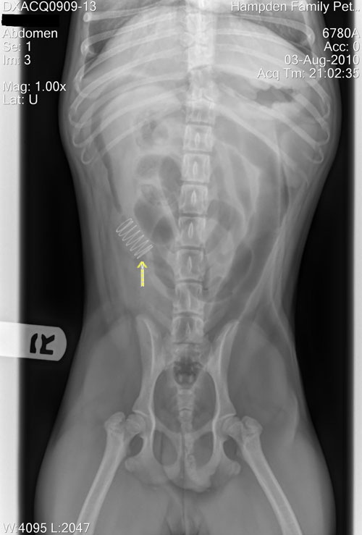
Incomplete obstruction of the intestine:
Complete obstruction of the intestine

Slide 5
Diagnosis
The case history is very important.
Symptoms
Palpation
X-ray film
X-ray film after a barium meal or capsule
X-ray film after barium enema

Slide 6
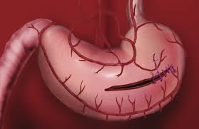
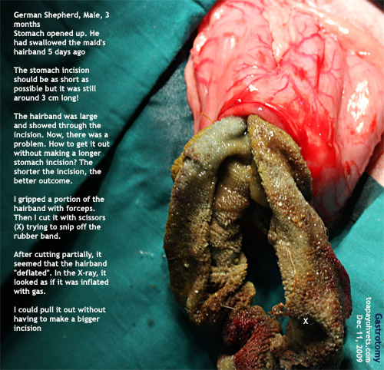
Treatment
Laparo-gastrotomy
Laparo-enterotomy

Slide 7
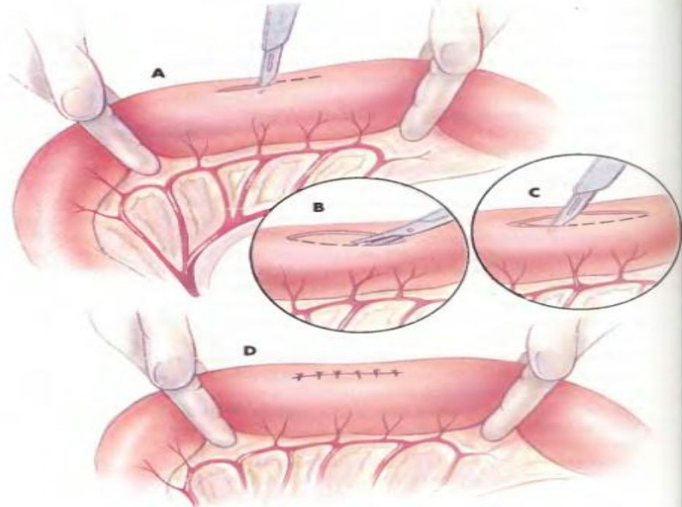
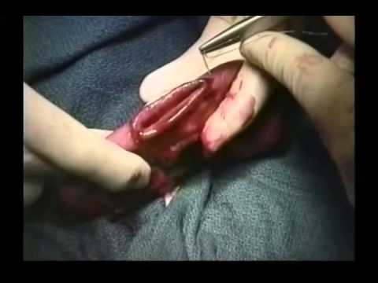
Enterotomy

Slide 8
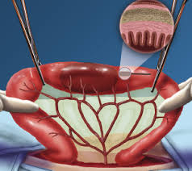
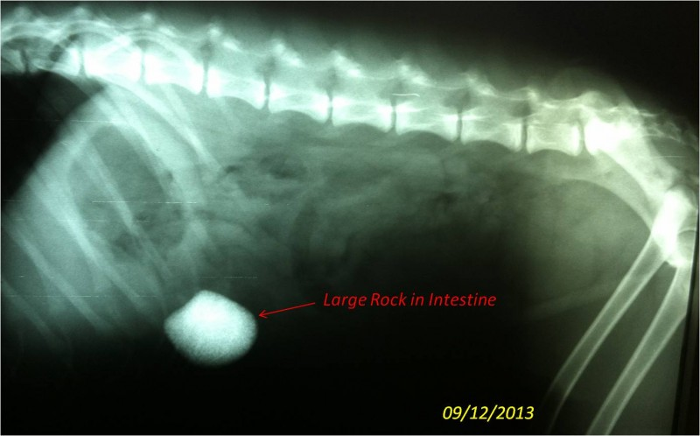
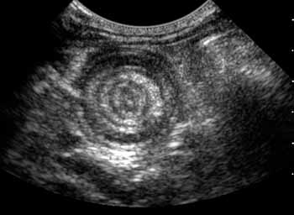
Intestinal intussusceptions

Slide 9
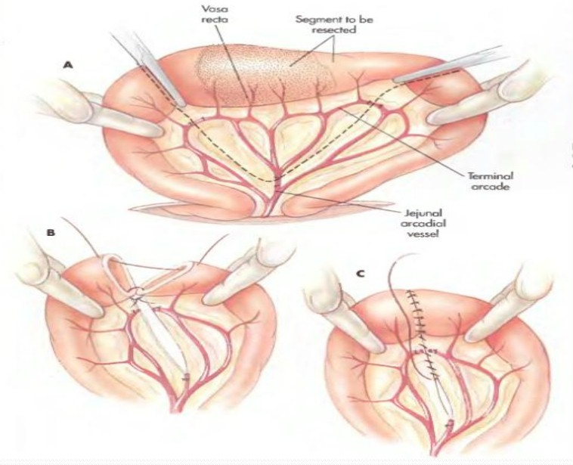
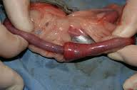
Intestinal Resection And Anastomosis

Slide 10
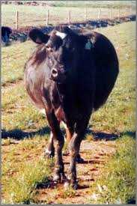
RUMINAL IMPACTION
Primary rumen impaction occurs in buffaloes and cattle mostly with depraved appetite.
Most of these animals eat plastics, ropes leather pieces and cloths

Slide 11
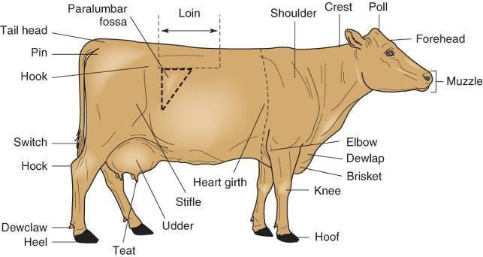
Clinical signs
Tympany.
Anorexia.
Leather pieces can produce obstruction at the reticulo-omasal orifice and most of them were recovered from the reticulum
Treatment
Rumenotomy

Slide 12
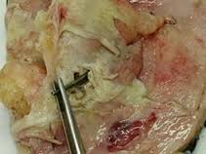
Traumatic Reticuloperotinitis
Traumatic reticulitis is a traumatic inflammation of the reticulum without inflammation of its serous membrane
Reticulo-peritonitis It means penetration of the wall of the reticulum by a hard object resulting in localized reticulitis and peritonitis

Slide 13
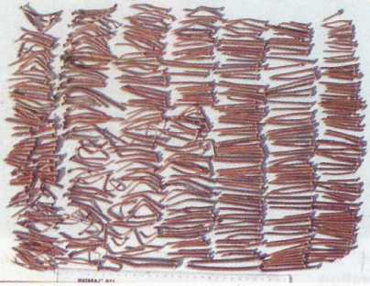
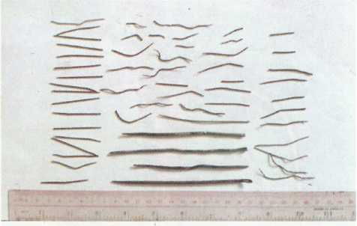
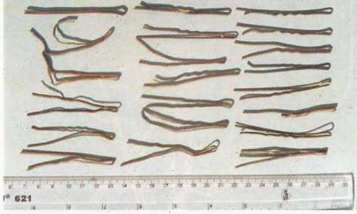
Causes:
Pieces of wire
Nails, needles, pieces of iron, screws
Nutritional deficiencies such as phosphorus

Slide 14
Pathogenesis
ventral ruminal sac cannot do any harm
omaso-abomasal orifice expelled with the faeces through the abomasum and intestine.
The reticulum, sharp foreign body penetrate the mucosa, musculosa and then serosa.
foreign body causes injury to the liver, intestine and diaphragm (abdominal cavity),
pericardium and lungs (thoracic cavity).

Slide 15
Symptoms
Loss of appetite.
Milk yield is significantly diminished.
The head is somewhat stretched and the back is arched (thoracic kyphosis and lumber lordosis).
Stiffness of the forelegs and abduction of the elbows is noticed
Turning the animal to one side
The animal grunts and is usually alert
Rumination is weak or absent
Feces are firm and decreased in quantity
Recurrent chronic tympany
Temperature, heart rate, respiratory rate normal

Slide 16
Diagnosis
Case history.
From the symptoms.
Pain tests
A- Raising the abdominal wall by means of a long piece of wood
B- The withers test
C- Percussion of the region of the xyphoid cartilage, sides of the chest and the abdominal wall by means of a strong percussion harmer
D- The back test
E- Going up and down a hill

Slide 17
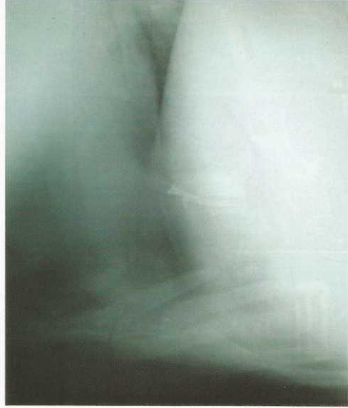
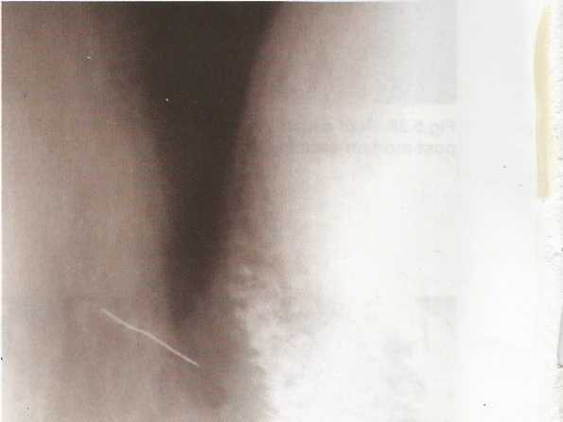
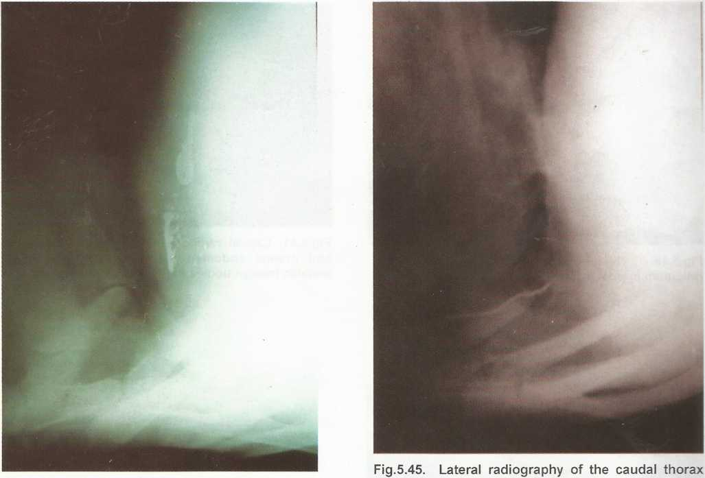
Diagnosis
Haematological examination
X-ray examination
Mine or metal detector

Slide 18
Complications for Traumatic reticulitis
Traumatic pneumonia
lung abscess
Localized peritonitis
Extensive spreading peritonitis
Liver abscess
Abscesses on the abdominal wall
Traumatic peri-carditis
Spleen abcess
Pleura pluritis
Intestinal rupture.
Vagal indigestion.
Diaphragmatic hernia

Slide 19
Traumatic Pericarditis (TP)
Traumatic pericarditis results from
penetration of a sharp foreign body into the pericardial sac.
First of all, the foreign body penetrates the reticulum then the diaphragm and finely penetrates the pericardium inducing pericarditis.
The condition is observed in cattle more than buffaloes and recorded mostly in pregnant animals at the latter stages of pregnancy or soon after parturition

Slide 20
Clinical signs of TP
A history of complete anorexia, loss of body weight and reduction of milk-yield
Sudden appearance of mandibular and brisket edema filling and pulsation of the jugular vein
In some cases, edema of the thoracic limbs and ventral abdominal wall was clear.
Arched back and winged elbows were evident in many cases.
Auscultation revealed muffled heart sound and dyspnia, increased pulse rate and rise of body temperature up to 40C.

Slide 21
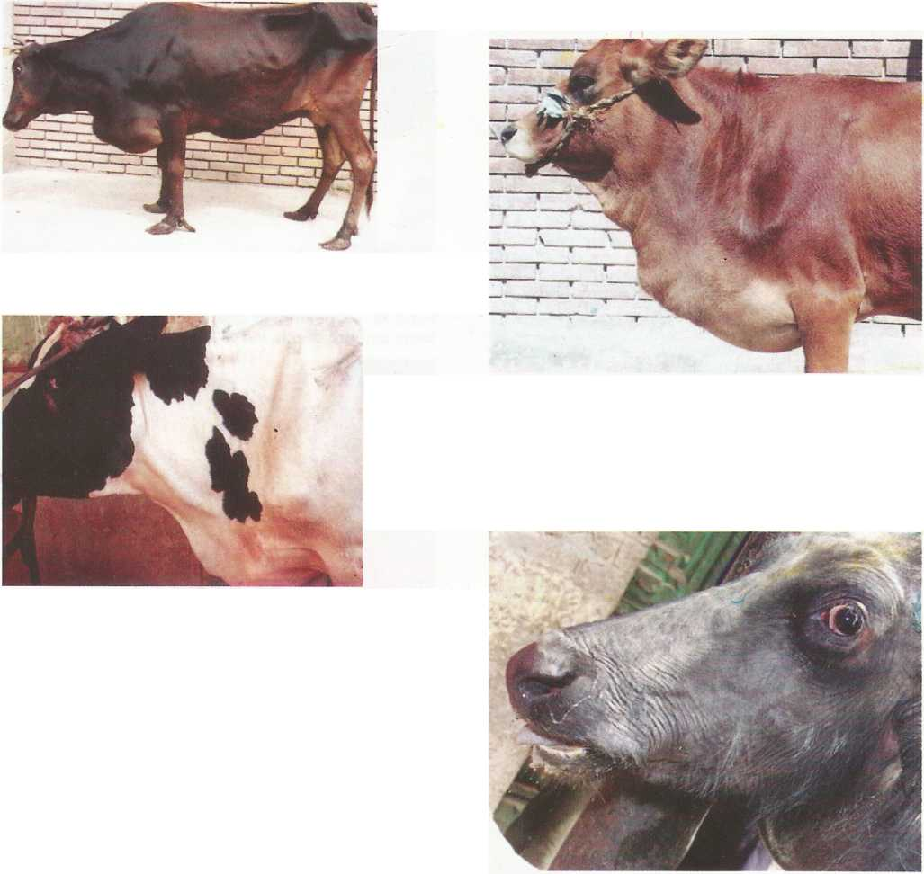

Slide 22
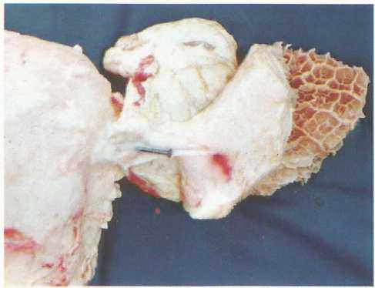
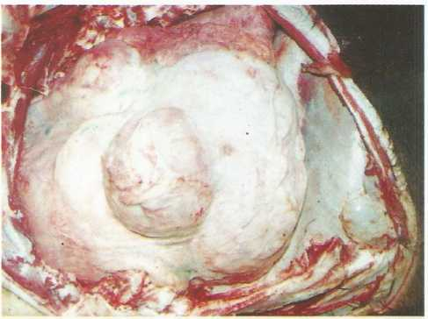
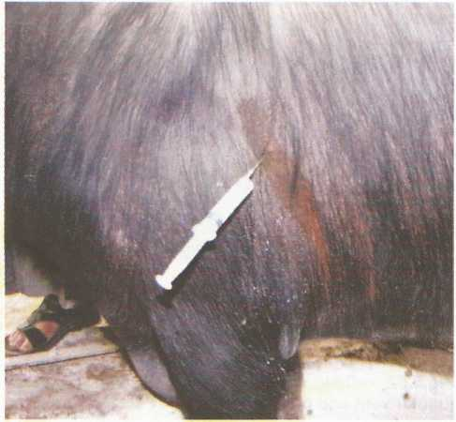
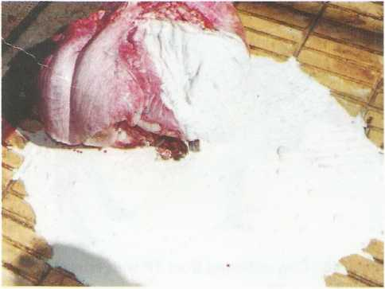

Slide 23
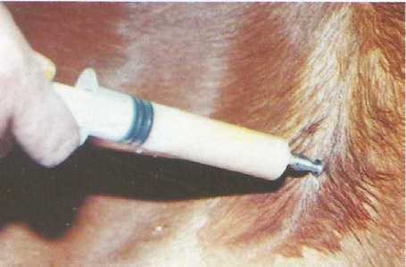
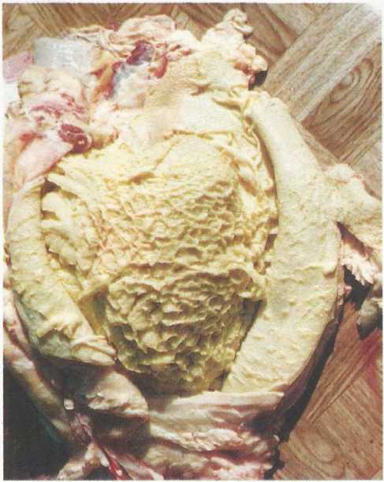
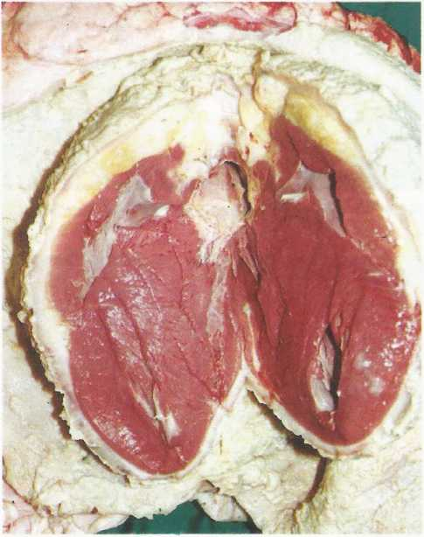

Slide 24
Necropsy findings of Tp
Adhesions between the reticulum, diaphragm and pericardium are observed.
Hydrothorax is seen in some cases.
A fibrous tissue cord connecting the reticulum and
pericardium is seen in many cases
In all cases, purulent exudates, often mixed with fibrin, are
filling the pericardial sac

Slide 25
Treatment of traumatic reticulitis
( (Rumenotomy
Indication:
Traumatic reticulitis or reticulo-peritonitis.
Persistent impaction of the rumen.
Intoxication with toxic plants or food.
For diagnosis

Slide 26
Animal control:
The operation is performed with the animal in the standing position either in a stanchion or box stall.
A kicking strep is applied above the hocks.
Tranquilization of the animal is indicated, xylazine HCl (Rumpon) in a dose rate of 0.05 mg/kg B.W. is used.
Anaesthesia is by a para-vertebral block or linear infiltration inverted “L” field block analgesia
Food and water should be withheld from the patient 24 hours prior to surgery. Although this is not essential in emergency cases.
The left flank area is prepared for aseptic surgery

Slide 27
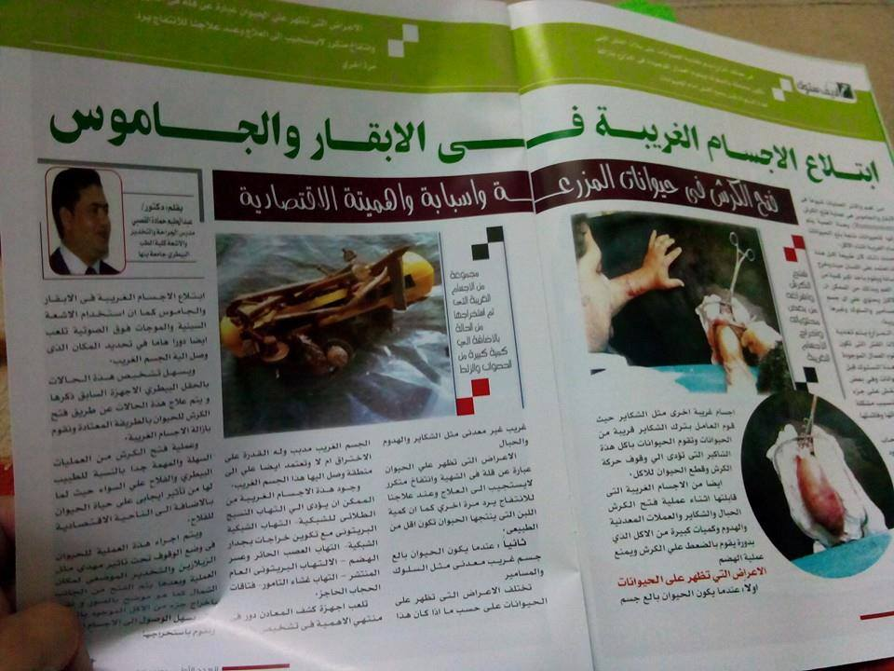

Slide 28
Operative techniques
Different techniques are used for rumenotomy:
Weingarth’s technique.
Goetze’s technique.
Andre’s technique.

Slide 29
Weingarth’s technique for rumenotomy
Preparation of flank region
Hand breadth from last rib and hand breadth from lumbar vertebrae and the incision performed parallel to last rib
The incision must be long enough to admit the surgeon’s hand (18-20 cm). The scalpel passed till the peritoneum, in the following layers:
Skin.
Subcutaneous tissue.
External oblique m.
Internal oblique m. (aponeurosis).
Transverse abdominal muscle

Slide 30
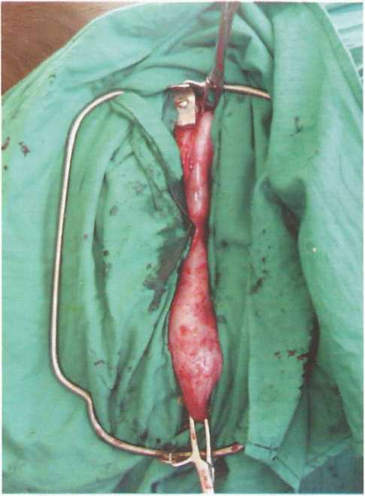
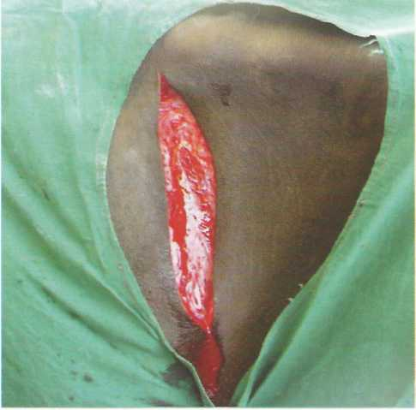

Slide 31
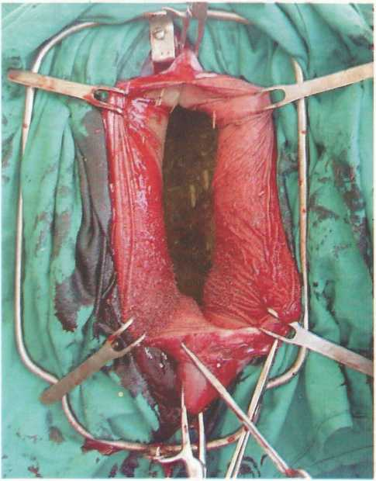

Slide 32
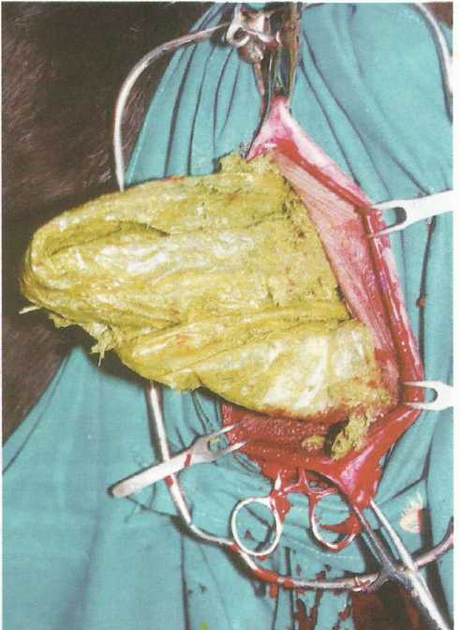
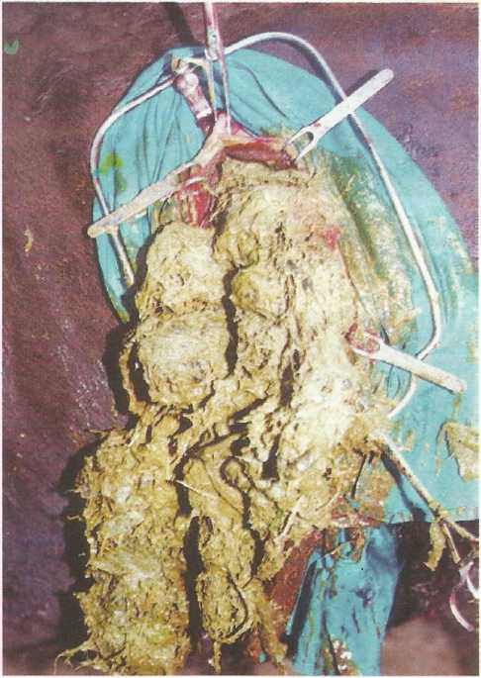
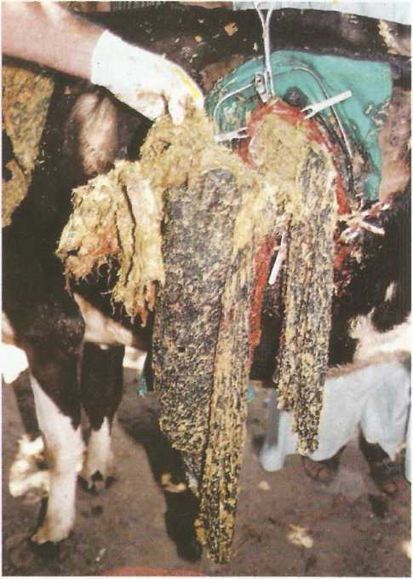

Slide 33
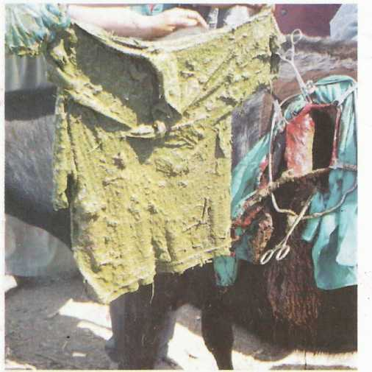
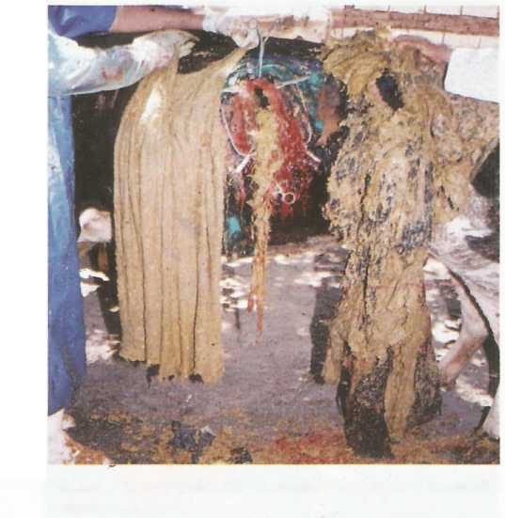

Slide 34
  Andre’s technique for rumenotomy
Proceed as described in weingarth’s technique till the rumen is reached,
then grasped with the hand and a large fold is taken out through the abdominal wall incision.
Two strong ruminal forceps are applied to the upper and lower edges of the fold of the rumen and well fixed by an assistant, so that the ruminal fold must kept outside the abdominal wound.
A sterile towel is placed around the protruding portion of the rumen to protect the abdominal cavity from contamination.
A vertical incision is then made in the wall of the rumen by means of a scalpel and widened by a scissors.
Each lip of the rumen wound is grasped by an artery forceps

Slide 35
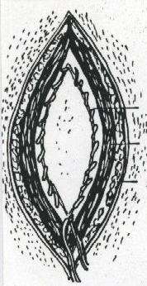
Gotze’s technique for rumenotomy
the ruminal fold is sutured to the parietal peritoneum and fascia so that it can not return back on being released.
The edges of the ruminal incision are lifted out of the wound with hooks or forceps
and fixed laterally, either to the skin
or to fixation ring then using
a special manschette to prevent contamination

Slide 37
THANK YOU

